Slide 1


Charge Injection System (CIS) Update
Peter Camporeale, Jacky Li
The University of Chicago
August 10, 2022

Slide 2
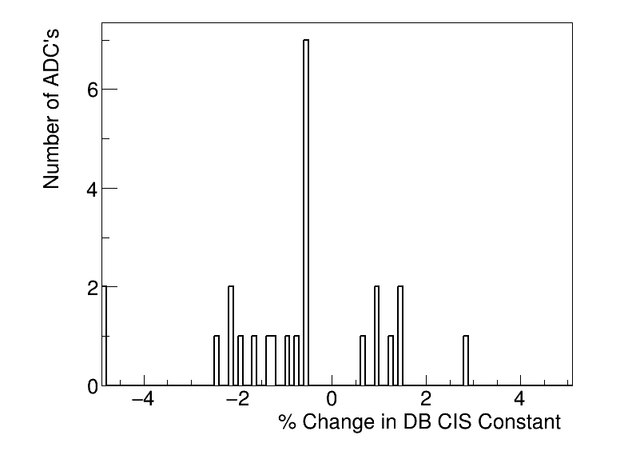
Summary
CIS runs from July 14 - August 8
Database will be updated August 12
25 channels in update
7 Good
2 >5% change
8 Masked
10 Affected

Slide 3
Run Selection
Date range: July 14 - August 8, 2022
Runs excluded: None
Runs used: 428271, 428437, 428535, 428588, 428791, 429095, 429224, 429253, 429493, 429511, 429799, 429890, 429948, 430406, 430444
No observed problems with Amplitude-Charge ratios (relatively flat with small scatter)
Timing plots are consistent by module and run rumbers

Slide 4
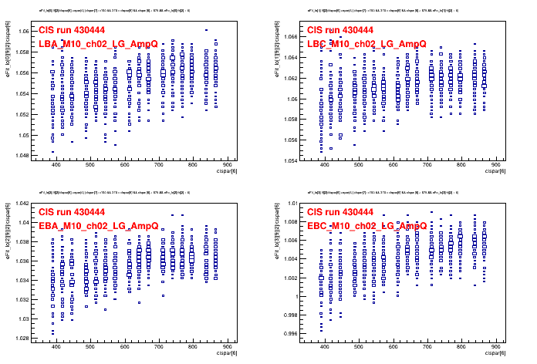
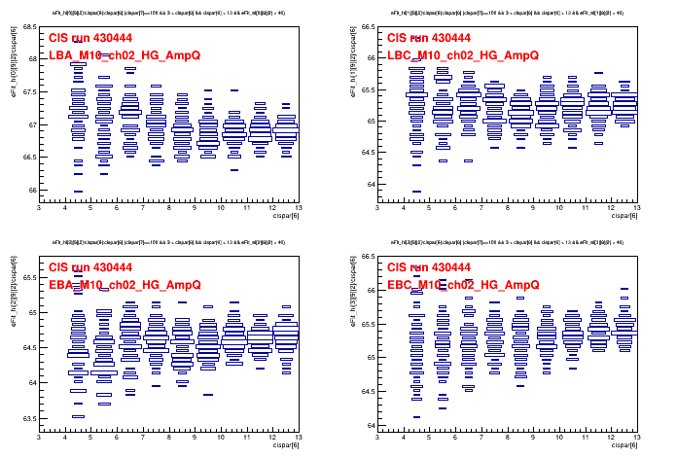
Representative Plots: Amp/Q: 430444
High gain
Low gain

Slide 5
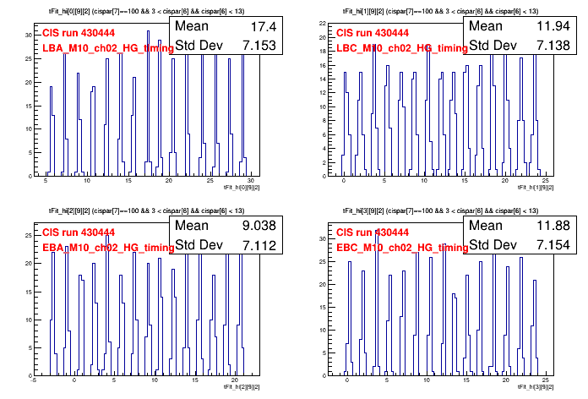
Representative Plots: Timing: 430444
High gain
Low gain

Slide 6
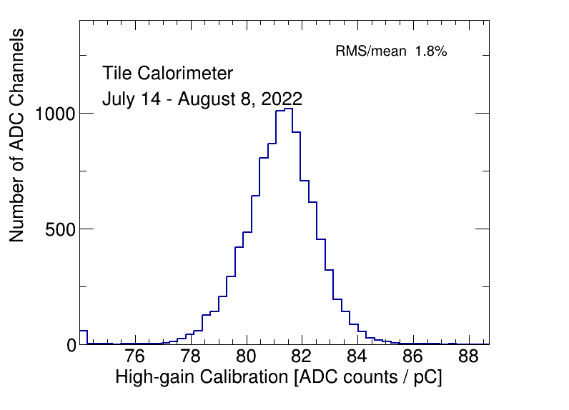
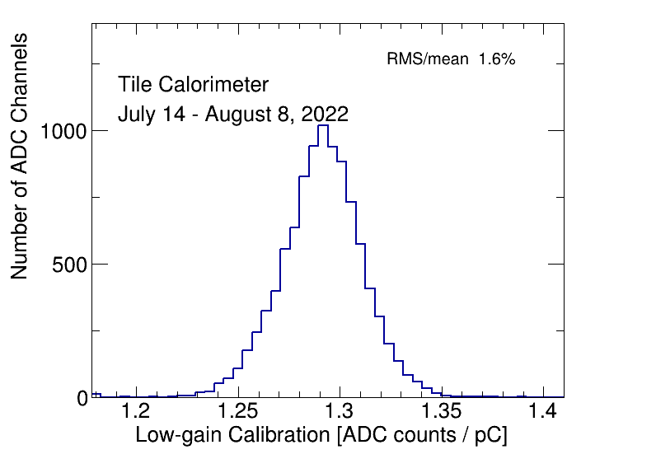
CIS Constant Distributions
Bump on HG distribution comes from demonstrator.

Slide 7
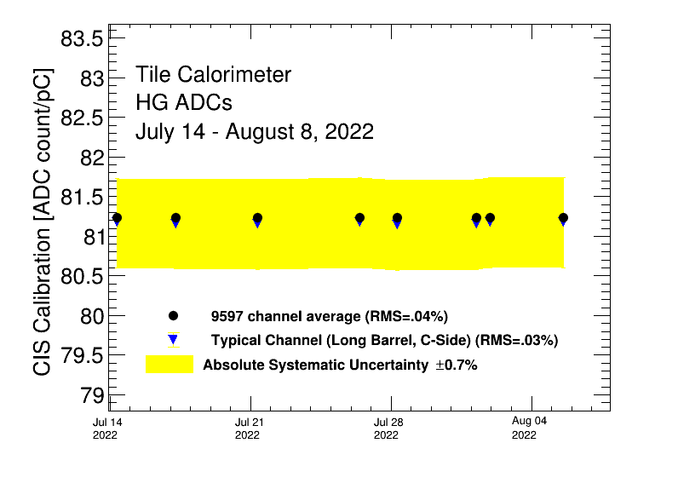
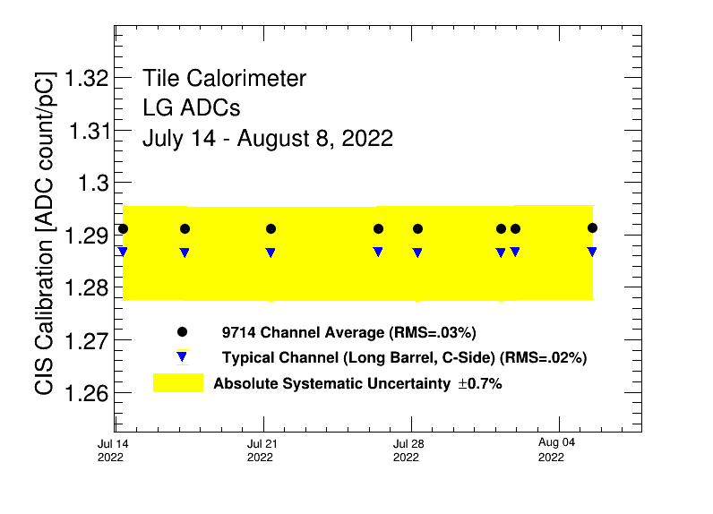
Detector Time Stability

Slide 8
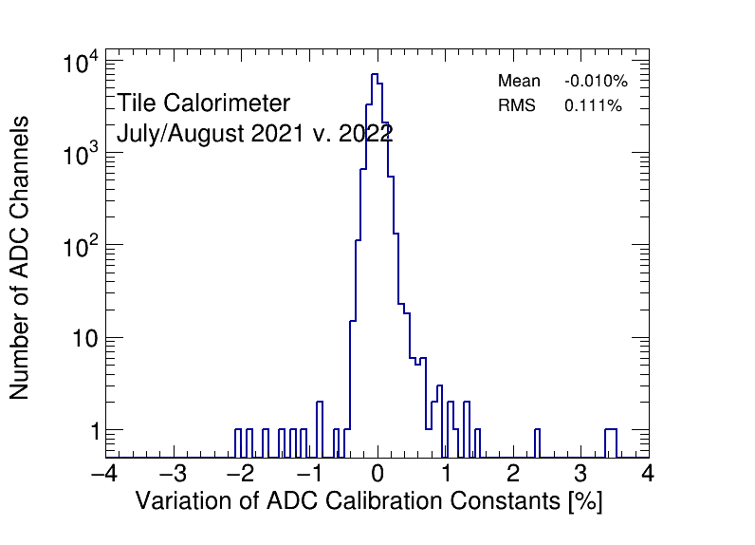
CIS Constant Long-Term Stability: 2021 vs 2022

Slide 9
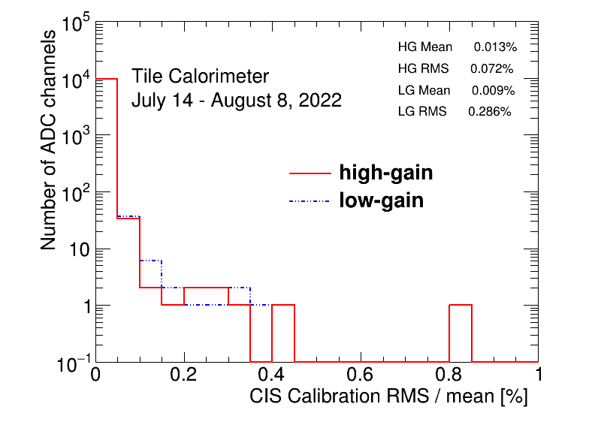
CIS Constant RMS/mean

Slide 10
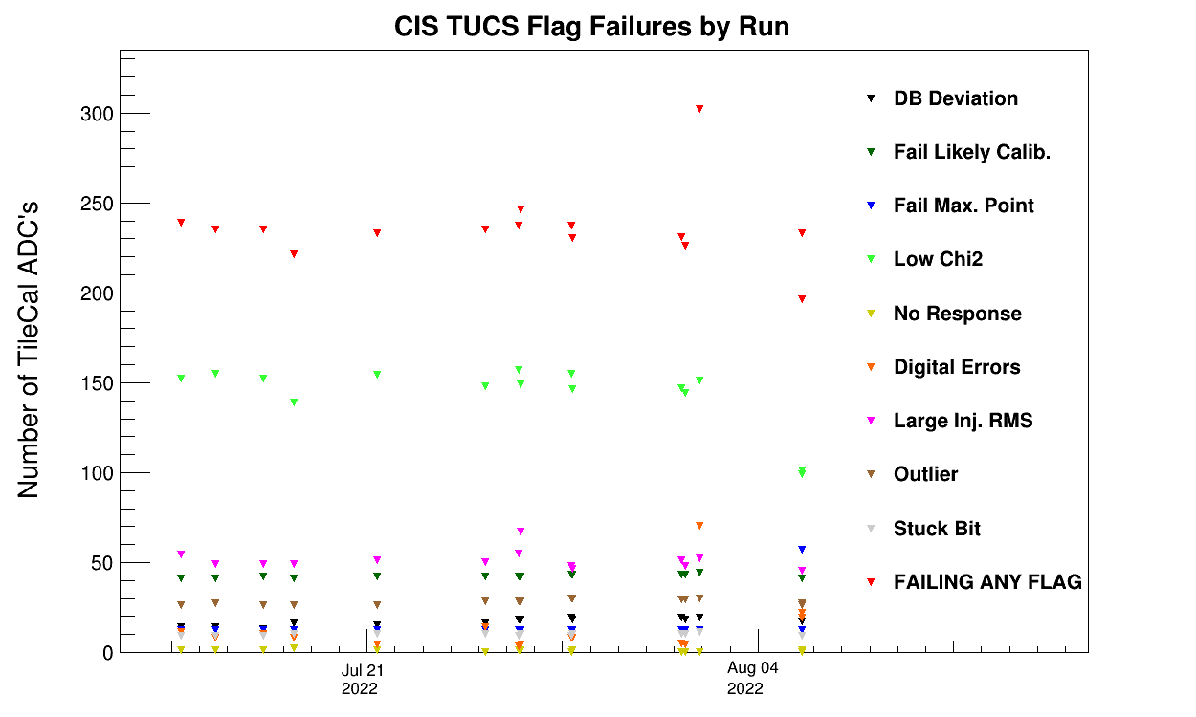
CIS TUCS Quality Flags
Investigating why there are more flags for this run
Run Number: 429948
Start Time: '2022-08-01 23:58:32
Notes:
**** which run is it that has the problems???

Slide 11
Interesting Channel Behaviour

Slide 12
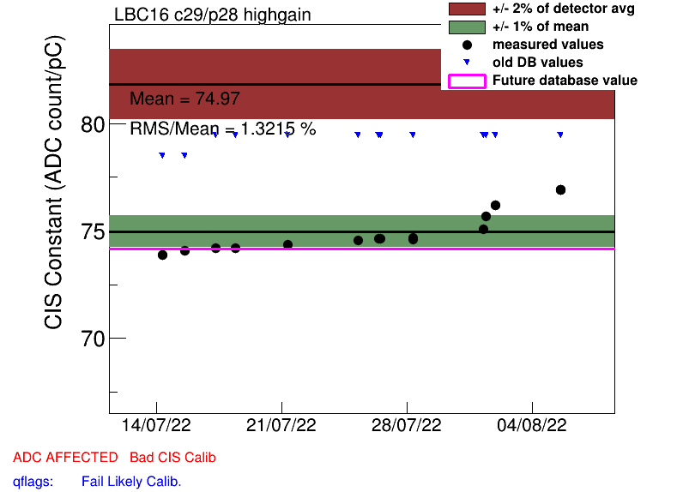
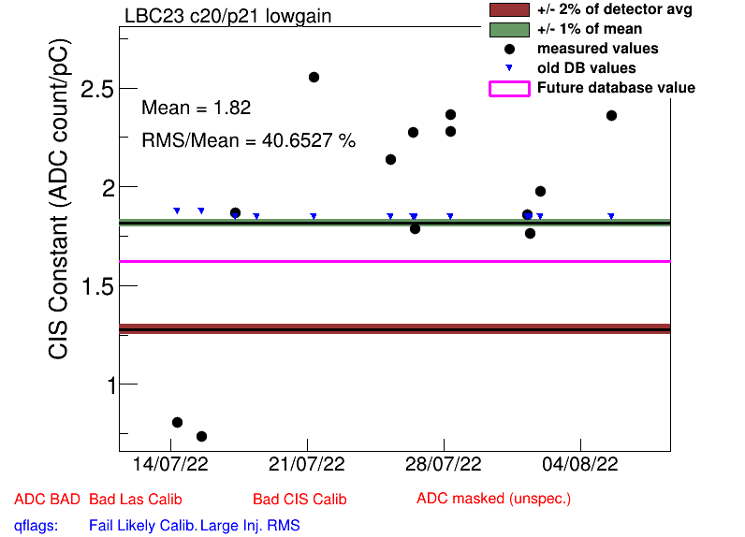
High Deviation from DB Mean (2)
OLD NEW CHANGE
LBC_m16_c29_highgain 79.44 74.15 -6.7%
LBC_m23_c20_lowgain 1.84 1.62 -12.1%

Slide 13
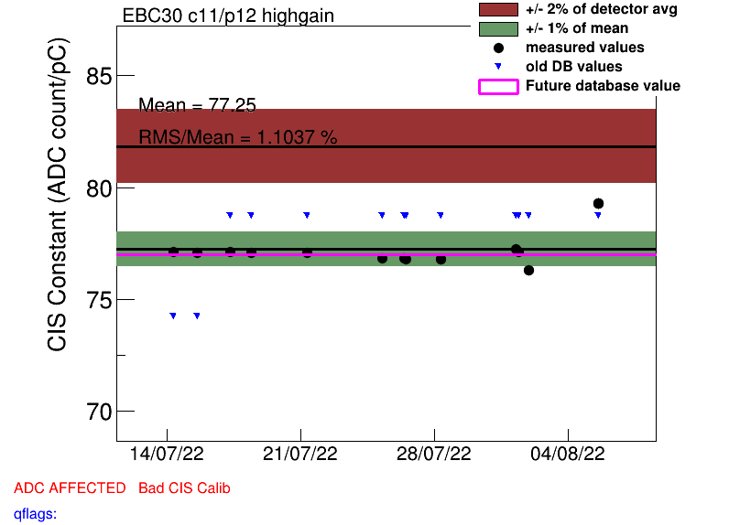
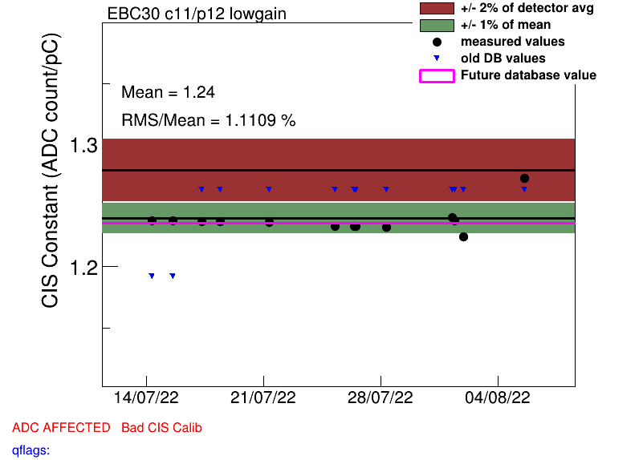
High Scatter Channels
EBC_m30_c11_highgain
LBC_m30_c11_lowgain

Slide 14
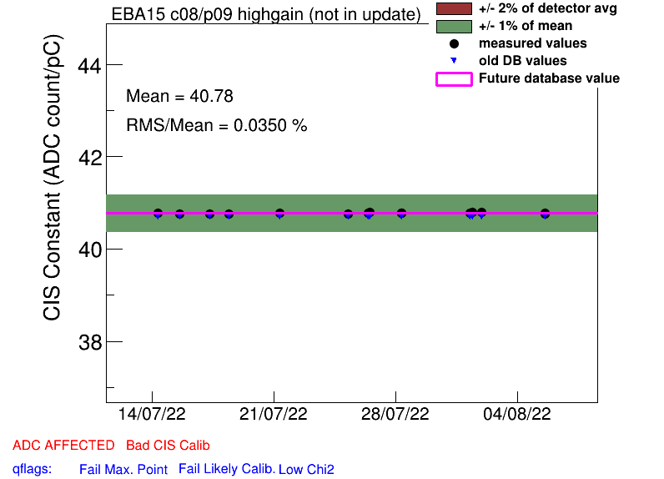
Half Gain Channels
EBA_m15_c08_highgain
EBA_m16_c00_highgain
EBA_m36_c15_highgain
EBA_m48_c31_lowgain
EBA_m64_c03_highgain
EBC_m09_c40_highgain
EBC_m21_c36_lowgain
LBA_m37_c19_highgain
LBC_m08_c03_lowgain
LBC_m19_c22_lowgain
(No changes from last update)
Affected
Masked
Notes:
No new half gain channels!

Slide 15
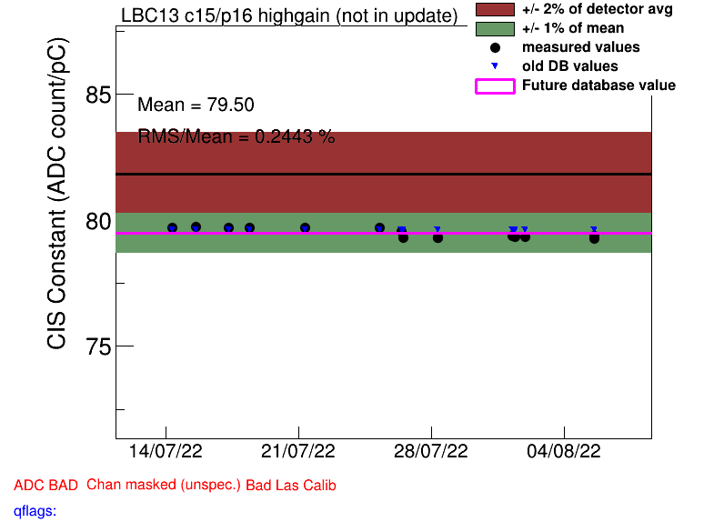
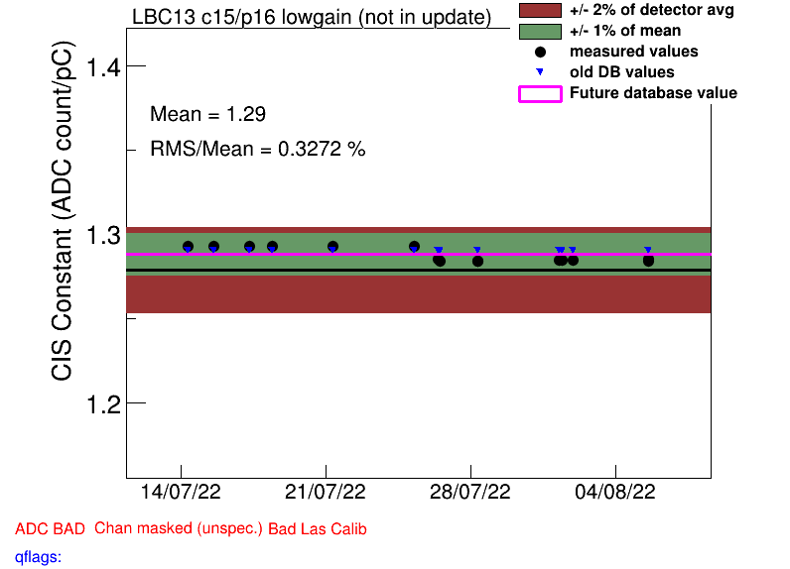
Channels to Recalibrate (2)
LBC_m13_c15_highgain (from 26/07)
LBC_m13_c15_lowgain (from 27/07)
LBC_m10_c37_highgain (from 21/07)

Slide 16
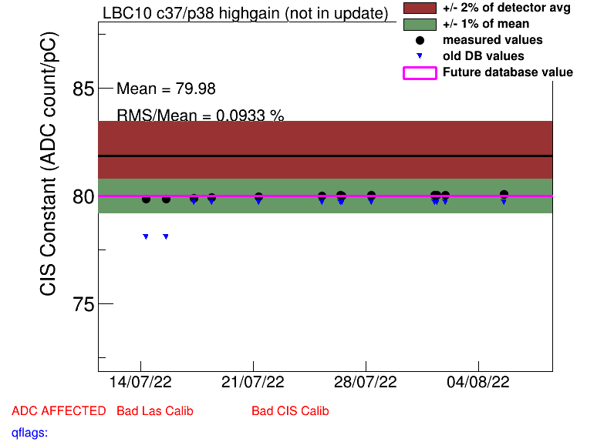
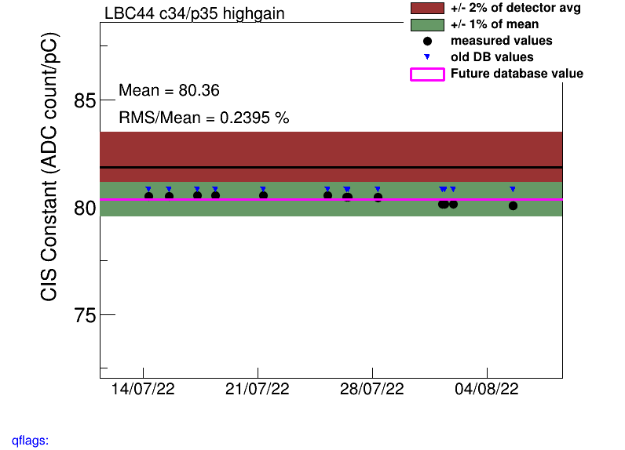
COOL Flag Updates
Remove BadCIS (2)
LBC_m10_c37_highgain
LBC_m63_c45_highgain
Add BadCIS (2)
LBA_m52_c01_lowgain
LBC_m44_c34_highgain

Slide 17
